Slide 1
CS2100 Tutorial 8
Song Kai
song.kai@nus.edu.sg

Slide 2
Demultiplexers
Input | Output | Purpose
Data D Select lines S_{n-1}, S_{n-2}, …, S₀ | D to line Y_{i} = S_{n-1}S_{n-2}…S₀ 0 to rest of the lines | Direct data from input to one selected output line.
Example: 1-to-4 demultiplexer.
Outputs
Y₀ = D∙S₁'∙S₀'
Y₁ = D∙S₁'∙S₀
Data D
demux
Y₂ = D∙S₁∙S₀'
Y₃ = D∙S₁∙S₀
S₁ S₀
select

Slide 3
Multiplexers
Input | Output | Purpose
2^{n} inputs I₀, I₁, … I₂n₋₁ Select lines S_{n-1}, S_{n-2}, …, S₁, S₀ | 1 output I_{i} among 2^{n} inputs, I_{i} = S_{n-1}S_{n-2}…S₁ S₀ | Select 1 data as output among 2^{n} inputs based on n selection lines
Truth table for a 4-to-1 multiplexer:
Inputs
Inputs
I₀
0
1
2
3
I₀
I₁
4:1
MUX
I₁
4:1
mux
I₂
Y
I₂
Y
Output
I₃
I₃
S₁ S₀
S₁ S₀
select
select

Slide 4
Multiplexers
Output of multiplexer is
“sum of the (product of data lines and selection lines)”
Example: Output of a 4-to-1 multiplexer is:
Y = ?
I₀∙(S₁'∙S₀') + I₁∙(S₁'∙S₀) + I₂∙(S₁∙S₀') + I₃∙(S₁∙S₀)
Note:
Expressing
I₀∙(S₁'∙S₀') + I₁∙(S₁'∙S₀) + I₂∙(S₁∙S₀') + I₃∙(S₁∙S₀)
in minterms notation, it is equal to
I₀∙m₀ + I₁∙m₁ + I₂∙m₂ + I₃∙m₃
This is useful later.

Slide 5
Multiplexers: Implementing Functions
F(A,B,C) = Σ m(1,3,5,6)
This method works because:
Output = I₀⋅m₀ + I₁⋅m₁ + I₂⋅m₂ + I₃⋅m₃ + I₄⋅m₄ + I₅⋅m₅ + I₆⋅m₆ + I₇⋅m₇
Supplying '1' to I₁,I₃,I₅,I₆ , and '0' to the rest:
Output = m₁ + m₃ + m₅ + m₆
0
1
0
1
0
1
1
0
0
1
2
3
4
5
6
7
F
mux
A B C
From slide 4:1 mux
Expressing
I₀∙(S₁'∙S₀') + I₁∙(S₁'∙S₀) + I₂∙(S₁∙S₀') + I₃∙(S₁∙S₀)
in minterms notation, it is equal to
I₀∙m₀ + I₁∙m₁ + I₂∙m₂ + I₃∙m₃
Notes:
At each input ABC, we decide what is the output.

Slide 6
Constructing Larger Multiplexers
Another implementation of an 8-to-1 multiplexer using smaller multiplexers:
When
S₂S₁S₀ = 000
I₀
I₁
2:1 MUX
I₀
I₁
S₂S₁S₀ = 101
I₂
I₃
2:1 MUX
I₂
0
S₀
I₃
1
4:1 MUX
I₀
0
S₀
Y
1
I₅
I₄
I₅
2:1 MUX
I₄
I₅
S₂ S₁
0 0
0
S₀
I₆
I₇
2:1 MUX
1 0
1
I₆
I₇
0
S₀
Q: Can we use only 2:1 multiplexers?
1

Slide 7
Using Smaller Multiplexers
3. Draw the truth table for function, by grouping inputs by selection line values, then determine multiplexer inputs by comparing input line (C) and function (F) for corresponding selection line values.
A | B | C | F | MUX input
0 | 0 | 0 | 1
0 | 0 | 1 | 1
0 | 1 | 0 | 0
0 | 1 | 1 | 1
1 | 0 | 0 | 0
1 | 0 | 1 | 0
1 | 1 | 0 | 1
1 | 1 | 1 | 0
1
C
0
C'
1
0
0
1
2
3
C
F
mux
A B


Slide 8
5. Using Smaller Multiplexers (5/6)
Alternative: What if we use A for input lines, and B, C for selector lines?
A' (when BC = 00)
A' (when BC = 01)
A (when BC = 10)
A
?
?
?
?
0
1
2
3
0
1
2
3
F
A' (when BC = 11)
F
mux
mux
B C
B C


Slide 9
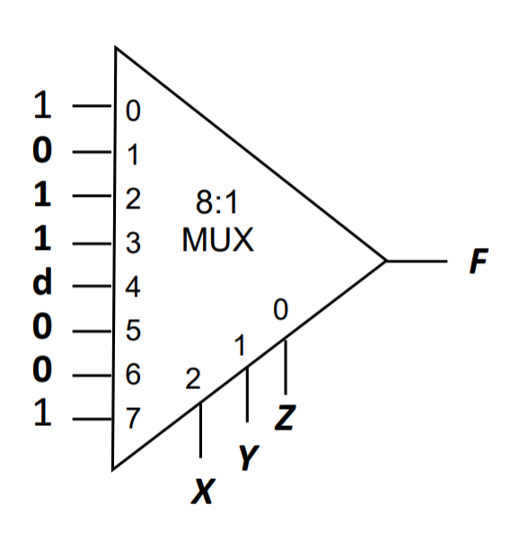

Q1 Multiplexer Realization
F(X,Y,Z) = Π M(1,5,6) ∙ Π D(4) = $\sum{m\left(0,2,3,7\right)+\sum{D(4)}}$
X | Y | Z | F
0 | 0 | 0 | 1
0 | 0 | 1 | 0
0 | 1 | 0 | 1
0 | 1 | 1 | 1
1 | 0 | 0 | d
1 | 0 | 1 | 0
1 | 1 | 0 | 0
1 | 1 | 1 | 1
Larger subscript → More significant bit

Slide 10
Q1 Multiplexer Realization
F(X,Y,Z) = Π M(1,5,6) ∙ D(4)
X | Y | Z | F
0 | 0 | 0 | 1 | Z'
0 | 0 | 1 | 0
0 | 1 | 0 | 1 | 1
0 | 1 | 1 | 1
1 | 0 | 0 | D | 0 / Z'
1 | 0 | 1 | 0
1 | 1 | 0 | 0 | Z
1 | 1 | 1 | 1
Z'
1
0
Z
0
1
2
3
4:1
MUX
F
0
1
Y
X

Slide 11
Q1 Multiplexer Realization
F(X,Y,Z) = Π M(1,5,6) ∙ D(4)
X | Y | Z | F
0 | 0 | 0 | 1
0 | 0 | 1 | 0
0 | 1 | 0 | 1
0 | 1 | 1 | 1
1 | 0 | 0 | D
1 | 0 | 1 | 0
1 | 1 | 0 | 0
1 | 1 | 1 | 1
Y | Z | X | F
0 | 0 | 0 | 1 | X' / 1
0 | 0 | 1 | D
0 | 1 | 0 | 0 | 0
0 | 1 | 1 | 0
1 | 0 | 0 | 1 | X'
1 | 0 | 1 | 0
1 | 1 | 0 | 1 | 1
1 | 1 | 1 | 1
1
0
X'
1
0
1
2
3
4:1
MUX
F
0
1
Z
Y

Slide 12
Decoders
Example: If codes 00, 01, 10, 11 are used to identify four light bulbs, we may use a 2-bit decoder.
2x4
DEC
F₀ F₁ F₂ F₃
Bulb 0
Bulb 1
Bulb 2
Bulb 3
2-bit code
X
Y
This is a 2×4 decoder which selects an output line based on the 2-bit code supplied.
Truth table:
X | Y | F₀ | F₁ | F₂ | F₃
0 | 0 | 1 | 0 | 0 | 0
0 | 1 | 0 | 1 | 0 | 0
1 | 0 | 0 | 0 | 1 | 0
1 | 1 | 0 | 0 | 0 | 1

Slide 13
Decoders
X | Y | F₀ | F₁ | F₂ | F₃
0 | 0 | 1 | 0 | 0 | 0
0 | 1 | 0 | 1 | 0 | 0
1 | 0 | 0 | 0 | 1 | 0
1 | 1 | 0 | 0 | 0 | 1
From truth table, circuit for 2×4 decoder is:
Note: Each output is a minterm (X'⋅Y', X'⋅Y, X⋅Y' or X⋅Y) of a 2-variable function
F₀ = X'⋅Y'
F₁ = X'⋅Y
F₂ = X⋅Y'
F₃ = X⋅Y
X
Y

Slide 14
Decoders with Enable
Decoders often come with an enable control signal, so that the device is only activated when the enable, E = 1.
Truth table:
F₀ = E⋅X'⋅Y'
E | X | Y | F₀ | F₁ | F₂ | F₃
1 | 0 | 0 | 1 | 0 | 0 | 0
1 | 0 | 1 | 0 | 1 | 0 | 0
1 | 1 | 0 | 0 | 0 | 1 | 0
1 | 1 | 1 | 0 | 0 | 0 | 1
0 | d | d | 0 | 0 | 0 | 0
F₁ = E⋅X'⋅Y
F₂ = E⋅X⋅Y'
F₃ = E⋅X⋅Y
Circuit of a 2×4 decoder with enable:
X
Y
E

Slide 15
2. Decoders with Enable (2/2)
In the previous slide, the decoder has a one-enable control signal, i.e. the decoder is enabled with E=1.
In most MSI decoders, enable signal is zero-enable, usually denoted by E' or Ē. The decoder is enabled when the signal is zero (low).
E | X | Y | F₀ | F₁ | F₂ | F₃
1 | 0 | 0 | 1 | 0 | 0 | 0
1 | 0 | 1 | 0 | 1 | 0 | 0
1 | 1 | 0 | 0 | 0 | 1 | 0
1 | 1 | 1 | 0 | 0 | 0 | 1
0 | d | d | 0 | 0 | 0 | 0
E' | X | Y | F₀ | F₁ | F₂ | F₃
0 | 0 | 0 | 1 | 0 | 0 | 0
0 | 0 | 1 | 0 | 1 | 0 | 0
0 | 1 | 0 | 0 | 0 | 1 | 0
0 | 1 | 1 | 0 | 0 | 0 | 1
1 | d | d | 0 | 0 | 0 | 0
Decoder with 1-enable
Decoder with 0-enable

Slide 16
Decoders
Input | Output | Purpose
Select lines S_{n-1}, S_{n-2}, …, S₁, S₀ 1 enable line | If enabled: 1 to line F_{i}=S_{n-1}S_{n-2}…S₁S₀ 0 to rest of the lines If not enabled: 0 to all lines | Pick one line out of 2^{n} lines
2x4
DEC
F₀ F₁ F₂ F₃
Bulb 0
Bulb 1
Bulb 2
Bulb 3
2-bit code
X
Y
E

Slide 17
Decoders: Implementing Functions Revisit
Example: Implement the following function using a 3×8 decoder and an appropriate logic gate
f(Q,X,P) = ∑ m(0,1,4,6,7) = ∏ M(2,3,5)
We may implement the function in several ways:
Using a decoder with active-high outputs with an OR gate: f(Q,X,P) = m₀ + m₁ + m₄ + m₆ + m₇
Using a decoder with active-low outputs with a NAND gate: f(Q,X,P) = (m₀' ⋅ m₁' ⋅ m₄' ⋅ m₆' ⋅ m₇' )'
Using a decoder with active-high outputs with a NOR gate: f(Q,X,P) = (m₂ + m₃ + m₅ )' [ = M₂ ⋅ M₃ ⋅ M₅ ]
Using a decoder with active-low outputs with an AND gate: f(Q,X,P) = m₂' ⋅ m₃' ⋅ m₅'

Slide 18
Decoders: Implementing Functions Revisit
f(Q,X,P) = Σm(0,1,4,6,7) = ∏ M(2,3,5)
0
1
2
3
4
5
6
7
0
1
2
3
4
5
6
7
Active-low → negated output
3x8
Dec
3x8
Dec
Q
X
P
A
B
C
f(Q,X,P)
Q
X
P
A
B
C
f(Q,X,P)
(m0'·m1'·m4'·m6'·m7)'
=m0+m1+m4+m6+m7
(a) Active-high decoder with OR gate.
(b) Active-low decoder with NAND gate.
0
1
2
3
4
5
6
7
0
1
2
3
4
5
6
7
3x8
Dec
3x8
Dec
f(Q,X,P)
f(Q,X,P)
Q
X
P
A
B
C
Q
X
P
A
B
C
(m2+m3+m5)'
= m2'·m3'·m5'
= M2·M3·M5
m2'·m3'·m5'
= M2·M3·M5
(c) Active-high decoder with NOR gate.
(d) Active-low decoder with AND gate.

Slide 19
Constructing Larger Decoders
Larger decoders can be constructed from smaller ones.
Example: A 3×8 decoder can be built from two 2×4 decoders (with one-enable) and an inverter.
3x8
DEC
F₀ = w'⋅x'⋅y'
F₁ = w'⋅x'⋅y
:
:
F₇ = w⋅x⋅y
0
1
:
:
7
w
x
y
S₂
S₁
S₀
2x4
DEC
w
x
y
0
1
2
3
F₀ = w'⋅x'⋅y'
F₁ = w'⋅x'⋅y
F₂ = w'⋅x⋅y'
F₃ = w'⋅x⋅y
S₁
S₀
E
2x4
DEC
0
1
2
3
F₄ = w⋅x'⋅y'
F₅ = w⋅x'⋅y
F₆ = w⋅x⋅y'
F₇ = w⋅x⋅y
S₁
S₀
E

Slide 20
Constructing Larger Decoders
Construct a 4×16 decoder from two 3×8 decoders with one-enable and an inverter.
4x16
DEC
w
x
y
z
S₃
S₂
S₁
S₀
0
1
:
:
15
F₀
F₁
:
:
F₁₅
3x8
DEC
w
x
y
z
0
1
:
7
F₀
F₁
:
F₇
S₂
S₁
S₀
E
3x8
DEC
S₂
S₁
S₀
0
1
:
7
F₈
F₉
:
F₁₅
E
Note: The input w and its complement w' are used to select either one of the two smaller decoders.

Slide 21
Q2 Decoder Realization
WXYZ = 1000 or 1011
WX is always 10
YZ is either 00 or 11
K(W,X,Y,Z) = Σ m(8,11)
one-enabled 2x4 decoder with normal outputs
Cin
Cin
2×4
DEC
2×4
DEC
W
X
S₁
0
1
2
3
Y
Z
S₁
0
1
2
3
K
S₀
S₀
E
E
1
Notes:
8 = 1000
11 = 1011
WX need to be 10
YZ can be either 00 or 11
It is only when WX is 10 then the second decode is enabled

Slide 22
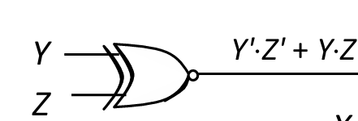
Q2 Decoder Realization
WXYZ = 1000 or 1011
WX is always 10
YZ is either 00 or 11
K(W,X,Y,Z) = Σ m(8,11)
one-enabled 2x4 decoder with normal outputs
Cin
2×4
DEC
X
S₁
0
1
2
3
K
S₀
Alternatives:
X to S₀
Y XOR Z
E
W
Notes:
8 = 1000
11 = 1011
WX need to be 10
YZ can be either 00 or 11
It is only when WX is 10 then the second decode is enabled
Take note of the cue for XNOR

Slide 23
Encoders
Contains 2^{n} (or fewer) input lines and n output lines.
Implemented with OR gates.
Example:
Input | Output | Purpose
2^{n} input lines with exactly one 1 | n bit output representing the input with value 1 | Give an encoding to based on the 2^{n} input
Not including priority encoders!
F₀
D₀
Select via switches
F₁
4-to-2 Encoder
F₂
2-bits code
F₃
D₁

Slide 24
Encoders
Truth table:
With K-map, we obtain:
D₀ = F1 + F3 D₁ = F2 + F3
Circuit:
F₀
F₁
D₀
F₂
F₃
D₁
Simple 4-to-2 encoder


Slide 25
Priority Encoders
A priority encoder is one with priority
If two or more inputs or equal to 1, the input with the highest priority takes precedence.
If all inputs are 0, this input combination is considered invalid.
Example of a 4-to-2 priority encoder:
Inputs |  |  |  | Outputs
D₀ | D₁ | D₂ | D₃ | f | g | V
0 | 0 | 0 | 0 | X | X | 0
1 | 0 | 0 | 0 | 0 | 0 | 1
X | 1 | 0 | 0 | 0 | 1 | 1
X | X | 1 | 0 | 1 | 0 | 1
X | X | X | 1 | 1 | 1 | 1

Slide 26
3. Priority Encoders (2/2)
Understanding “compact” function table
Inputs |  |  |  | Outputs
D₀ | D₁ | D₂ | D₃ | f | g | V
0 | 0 | 0 | 0 | X | X | 0
1 | 0 | 0 | 0 | 0 | 0 | 1
X | 1 | 0 | 0 | 0 | 1 | 1
X | X | 1 | 0 | 1 | 0 | 1
X | X | X | 1 | 1 | 1 | 1
Inputs |  |  |  | Outputs
D₀ | D₁ | D₂ | D₃ | f | g | V
0 | 0 | 0 | 0 | X | X | 0
1 | 0 | 0 | 0 | 0 | 0 | 1
0 | 1 | 0 | 0 | 0 | 1 | 1
1 | 1 | 0 | 0 | 0 | 1 | 1
0 | 0 | 1 | 0 | 1 | 0 | 1
0 | 1 | 1 | 0 | 1 | 0 | 1
1 | 0 | 1 | 0 | 1 | 0 | 1
1 | 1 | 1 | 0 | 1 | 0 | 1
0 | 0 | 0 | 1 | 1 | 1 | 1
0 | 0 | 1 | 1 | 1 | 1 | 1
0 | 1 | 0 | 1 | 1 | 1 | 1
0 | 1 | 1 | 1 | 1 | 1 | 1
1 | 0 | 0 | 1 | 1 | 1 | 1
1 | 0 | 1 | 1 | 1 | 1 | 1
1 | 1 | 0 | 1 | 1 | 1 | 1
1 | 1 | 1 | 1 | 1 | 1 | 1
Exercise: Obtain the simplified expressions for f, g and V.


Slide 27
MSI Summary
 | Input | Output | Purpose
Encoders | 2^{n} input lines with exactly one 1 | n bit output representing the input with value 1 | Give an encoding to based on the 2^{n} input
Priority Encoders | 2^{n} input lines with some 1s | n bit output representing the input with value 1 of highest priority | Give an encoding to based on the 2^{n} input
Decoders | Select lines S_{n-1}, S_{n-2}, …, S₁, S₀ 1 enable line | If enabled: 1 to line F_{i}=S_{n-1}S_{n-2}…S₁S₀ 0 to rest of the lines If not enabled: 0 to all lines | Picks one line out of 2^{n} lines
Multiplexers | 2^{n} inputs I₀, I₁, … I₂n₋₁ Select lines S_{n-1}, S_{n-2}, …, S₁, S₀ | 1 output I_{i} among 2^{n} inputs, I_{i} = S_{n-1}S_{n-2}…S₁ S₀ | Select 1 data as output among 2^{n} inputs based on n selection lines
Demultiplexers | Data D Select lines S_{n-1}, S_{n-2}, …, S₁, S₀ | D to line Y_{i} = S_{n-1}S_{n-2}…S₀ 0 to rest of the lines | Direct data from input to one selected output line.

Slide 28
Q3 Converter Design
A | B | C | D | F | G | H
0 | 0 | 0 | 0 | 0 | 0 | 0
1 | 0 | 0 | 0 | 0 | 0 | 1
1 | 1 | 0 | 0 | 0 | 1 | 0
1 | 1 | 1 | 0 | 0 | 1 | 1
1 | 1 | 1 | 1 | 1 | 0 | 0
0 | 1 | 1 | 1 | 1 | 0 | 1
0 | 0 | 1 | 1 | 1 | 1 | 0
0 | 0 | 0 | 1 | 1 | 1 | 1
When A = 1, FGH = #1s in ABCD
When A = 0,
FGH = 4 + #0s in ABCD
FGH = 2 x #0s in ABCD + #1s in ABCD

Slide 29
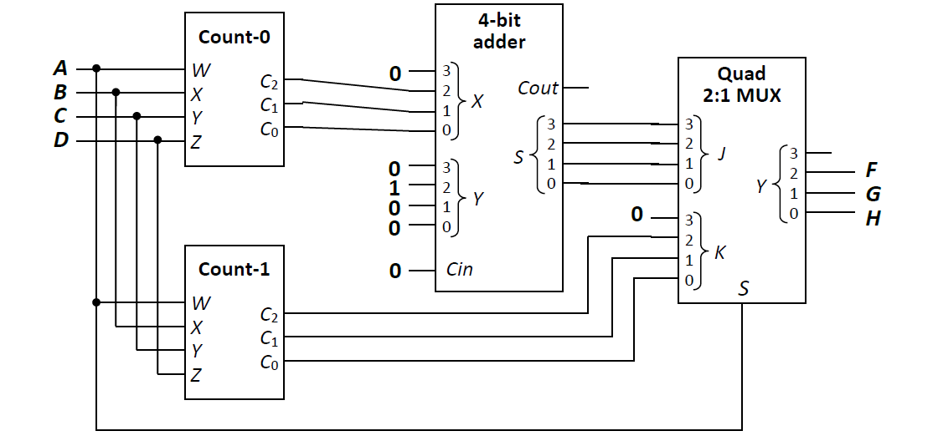
Q3 Converter Design
When A = 1, FGH = #1s in ABCD
When A = 0,
FGH = 4 + #0s in ABCD
No. of 0s + 4
Selection line comes from value of A
No. of 1s

Slide 30
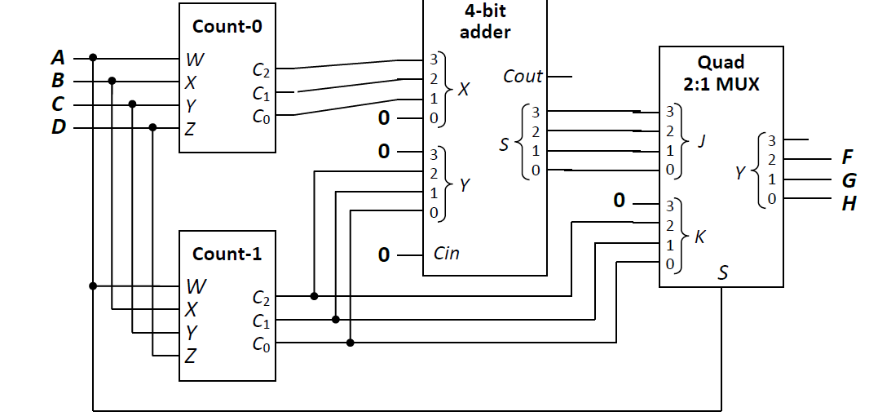
Q3 Converter Design
When A = 1, FGH = #1s in ABCD
When A = 0,
FGH = 2 x #0s in ABCD + #1s in ABCD
2x No. of 0s + No. of 1s
Selection line comes from value of A
No. of 1s

Slide 31
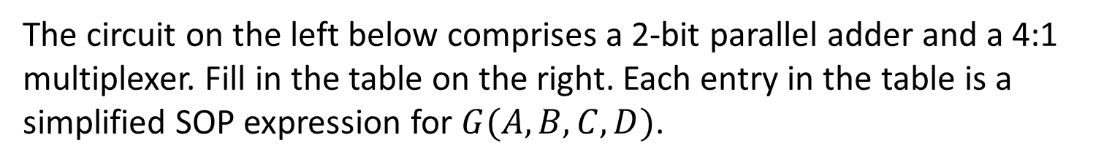
Q4.
The circuit on the left below comprises a 2-bit parallel adder and a 4:1 multiplexer. Fill in the table on the right. Each entry in the table is a simplified SOP expression for $G(A,B,C,D)$.
A | B | C | D | C_{out} | S₁ | S₀ | 1
0 | 0 | 0 | 0 | 0 | 0 | 0 | 1
0 | 0 | 0 | 1 | 0 | 0 | 1 | 1
0 | 0 | 1 | 0 | 0 | 1 | 0 | 1
0 | 0 | 1 | 1 | 0 | 1 | 1 | 1
0 | 1 | 0 | 0 | 0 | 0 | 1 | 1
0 | 1 | 0 | 1 | 0 | 1 | 0 | 1
0 | 1 | 1 | 0 | 0 | 1 | 1 | 1
0 | 1 | 1 | 1 | 1 | 0 | 0 | 1
1 | 0 | 0 | 0 | 0 | 1 | 0 | 1
1 | 0 | 0 | 1 | 0 | 1 | 1 | 1
1 | 0 | 1 | 0 | 1 | 0 | 0 | 1
1 | 0 | 1 | 1 | 1 | 0 | 1 | 1
1 | 1 | 0 | 0 | 0 | 1 | 1 | 1
1 | 1 | 0 | 1 | 1 | 0 | 0 | 1
1 | 1 | 1 | 0 | 1 | 0 | 1 | 1
1 | 1 | 1 | 1 | 1 | 1 | 0 | 1
2-bit
Adder
0
Cin
A
B
X₁
X₀
Y₁
Y₀
Cout
0
1
2
3
S₁
S₀
4:1
MUX
C
D
G
1
S₁
S₀
A | B | G(A,B,C,D)
0 | 0
0 | 1
1 | 0
1 | 1
0
C’⋅D + C⋅D’
D
1

Slide 32
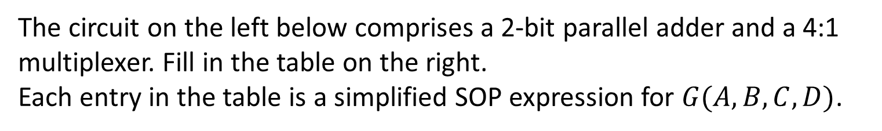
Q4.
The circuit on the left below comprises a 2-bit parallel adder and a 4:1 multiplexer. Fill in the table on the right.
Each entry in the table is a simplified SOP expression for $G(A,B,C,D)$.
2-bit
Adder
Selection lines: AB
When A = B = 0, Cout is selected, which is always 0.
G = 0
When A = 0, B = 1, S1 is selected. Consider different CD values.
If CD = 00 / 11, AB + CD = 01/100, S1 = 0
If CD = 01 / 10, AB + CD = 10 / 11, S1 = 1
G = C XOR D = C’.D + C.D’
When A = 1, B = 0, S0 is selected. Consider different CD values,
If CD = 00 / 10, AB + CD = 10 / 100, S0 = 0
If CD = 01 / 11, AB + CD = 11 / 101, S0 = 1
G = D
When A = B = 1, input 3 is always 1.
G = 1
0
Cin
A
B
X₁
X₀
Y₁
Y₀
Cout
0
1
2
3
S₁
S₀
4:1
MUX
C
D
G
1
S₁
S₀
A | B | G(A,B,C,D)
0 | 0
0 | 1
1 | 0
1 | 1
0
C’⋅D + C⋅D’
D
1
Notes:
XOR is not part of SOP

Slide 33
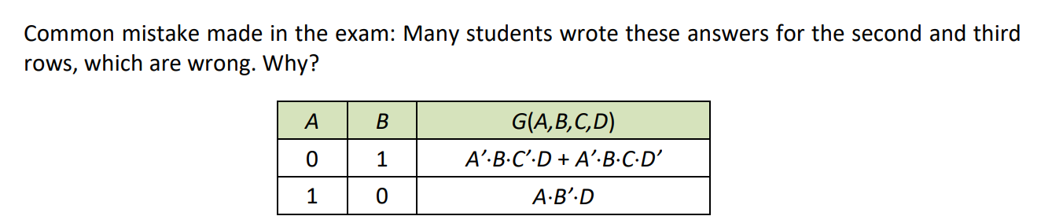
Q4.
The circuit on the left below comprises a 2-bit parallel adder and a 4:1 multiplexer. Fill in the table on the right.
Each entry in the table is a simplified SOP expression for $G(A,B,C,D)$.
For each row, derive the simplified SOP expression for G as a function of C and D only
A | B | G(A,B,C,D)
0 | 0
0 | 1
1 | 0
1 | 1
2-bit
Adder
0
Cin
0
A
B
X₁
X₀
Y₁
Y₀
Cout
0
1
2
3
C’⋅D + C⋅D’
S₁
S₀
4:1
MUX
C
D
G
D
1
S₁
S₀
1

Slide 34
Q5.
The circuit below uses an 8-3 priority encoder whose function is described in the table. What are the simplified SOP expressions for $H2\left(A,B,C\right), H1(A,B,C)$ and $H0(A,B,C)$?
F7 | F6 | F5 | F4 | F3 | F2 | F1 | F0 | Y2 | Y1 | Y0
0 | 0 | 0 | 0 | 0 | 0 | 0 | 0 | X | X | X
0 | 0 | 0 | 0 | 0 | 0 | 0 | 1 | 0 | 0 | 0
0 | 0 | 0 | 0 | 0 | 0 | 1 | X | 0 | 0 | 1
0 | 0 | 0 | 0 | 0 | 1 | X | X | 0 | 1 | 0
0 | 0 | 0 | 0 | 1 | X | X | X | 0 | 1 | 1
0 | 0 | 0 | 1 | X | X | X | X | 1 | 0 | 0
0 | 0 | 1 | X | X | X | X | X | 1 | 0 | 1
0 | 1 | X | X | X | X | X | X | 1 | 1 | 0
1 | X | X | X | X | X | X | X | 1 | 1 | 1
8-to-3 priority
encoder
A
F7
F6
F5
F4
F3
F2
F1
F0
Y2
Y1
Y0
H2(A,B,C)
B
H1(A,B,C)
C
H0(A,B,C)
1
A | B | C | F7 | F6 | F5 | F4 | F3 | F2 | F1 | F0 | H2 | H1 | H0
0 | 0 | 0 | 0 | 0 | 0 | 0 | 0 | 0 | 1 | 1
0 | 0 | 1 | 0 | 0 | 0 | 0 | 1 | 1 | 1 | 1
0 | 1 | 0 | 0 | 0 | 1 | 1 | 0 | 0 | 1 | 1
0 | 1 | 1 | 0 | 0 | 1 | 1 | 1 | 1 | 1 | 1
1 | 0 | 0 | 1 | 1 | 0 | 0 | 0 | 0 | 1 | 1
1 | 0 | 1 | 1 | 1 | 0 | 0 | 1 | 1 | 1 | 1
1 | 1 | 0 | 1 | 1 | 1 | 1 | 0 | 0 | 1 | 1
1 | 1 | 1 | 1 | 1 | 1 | 1 | 1 | 1 | 1 | 1
H2 = A + B
0 0 1
0 1 1
H1 = A + B’⋅C
1 0 1
1 0 1
H0 = 1
1 1 1
1 1 1
1 1 1
1 1 1
Notes:
F6, F4, F2, F0 they do not matter

Slide 35
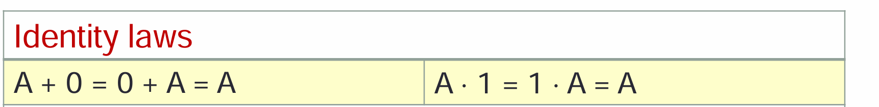
Assignment 2 Feedback
Q1
RR1 / RR2: 21 / $21 / $s5 are accepted.
Do take note of
base, e.g. 0b____, 0x____
number of bits, e.g. Instruction[31-26]* has 6 bits, and Instruction[25-21]* has 5 bits
Q2(b)
The last step is by the zero element theorem. Not by identity or annihilation.
There are multiple names for the same Boolean laws / theorems. Do use the ones given in CS2100.
Q2(c): How many minterms does a 2-literal product term in 𝐹 have
Why 40?

Slide 36
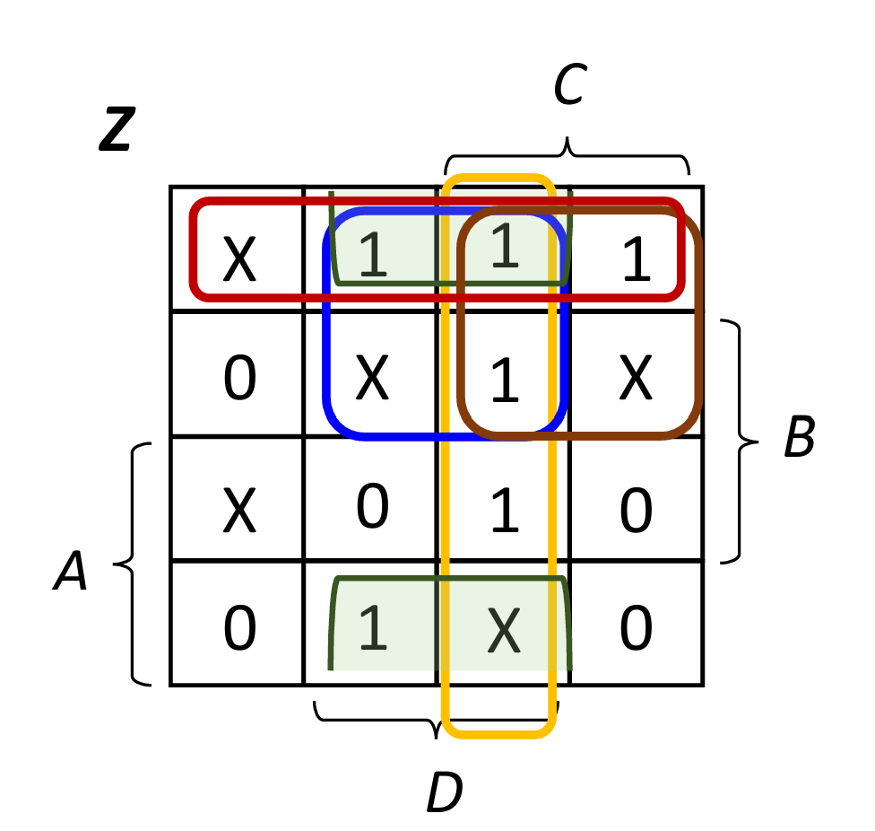
Assignment 2 Feedback
Q4(b): There are only two EPIs for Z.
Q4(d)
All EPIs need to be written before PIs.
Don’t miss the dot (.)
Q4(e): Some of you have all the literals inverted.
Q5(c): We should have some don't-care terms for P.
Q5(e): Another alternative is (A XNOR B) NAND (C XNOR D)
Careless Mistakes:
Extra right bracket at the end (A XOR B).(C XOR D))
Extra zeros e.g. 000000E98
The single quote copied from other sources may not be displayed correctly in Canvas.
Notes:
Errata all expressions can be written as both SOP and POS

Slide 37
CS2100 Tutorial 8
Song Kai
song.kai@nus.edu.sg

